Slide 1
Bicycle Model Explanation
Linear Control Systems - 24677
Notes:
Main title: 40 pt. Arial
Presenter Name: 16 pt. Arial
Presenters Title: 16 pt. Arial Italic

Slide 2
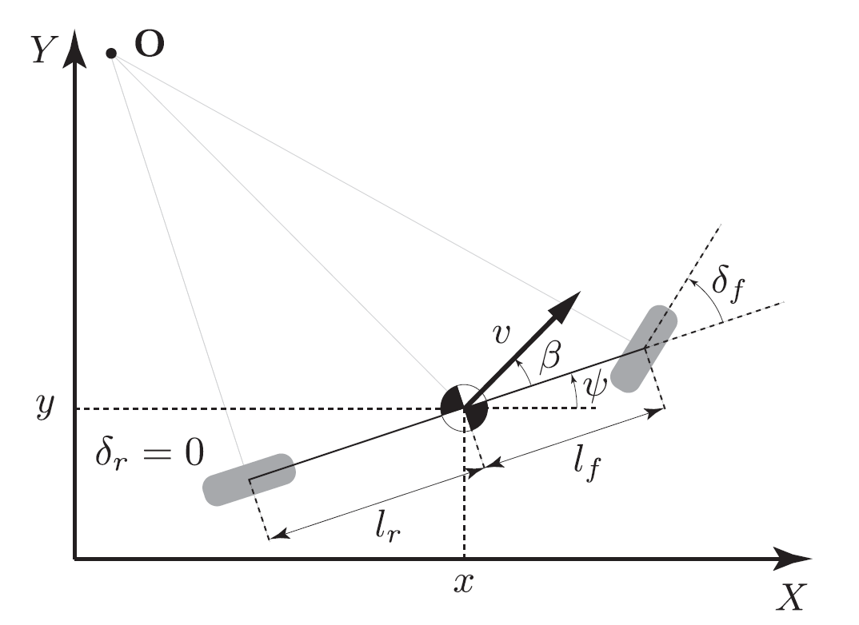




Overview
$$Y_{Vehicle}$$
$$X_{Vehicle}$$
$$\dot{x}$$
$$\dot{y}$$
Notes:
The bicycle model is a simplistic, but effective, model for four-wheeled vehicles. We simplify the four wheels to two – one in the back, and one in the front.
The center of gravity is denoted by the black-and-white circle at the center of the body. We derive our kinematic equations from this reference point.
The X and Y coordinate axes define the world frame. Small x and y are thus the coordinates of the center of gravity in this frame. (In the project code, we use big X and Y to define these.)
psi is our heading angle, defined as the angle between the world’s X-axis and the body of the vehicle. We use this angle to define the vehicle’s reference frame – the vehicle’s longitudinal axis (along the body) and lateral axis.
v is the overall velocity of the vehicle in the vehicle’s reference frame. This velocity is defined from beta, the slip angle. For our project, we break v into two components via beta – xdot and ydot. In other words, we define velocity components in terms of the vehicle’s reference frame – not the world!
lr and lf are the distances from the center of gravity to the rear and front wheels, respectively.
delta_f is our steering angle, which is defined as the angle between the vehicle’s longitudinal axis and the front wheel. This becomes one of our control inputs - delta. delta_r, the rear steering angle, is always zero, as this wheel is not controllable.
Our other control input is F, which is a force applied to the center of gravity. It is not shown in this diagram. Due to some Webots limitations, this requires conversion to a throttle input.

Slide 3
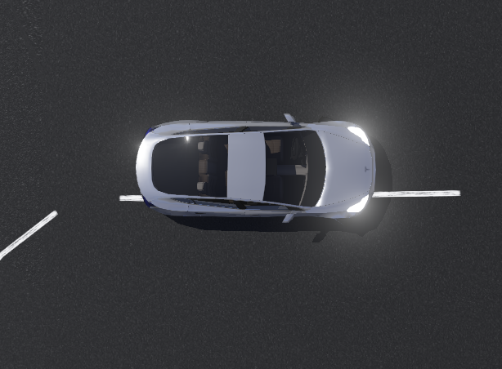








Looking at the Project
$$Y_{Vehicle}$$
$$Y$$
$$v$$
$$\dot{y}$$
$$X_{Vehicle}$$
$$δ$$
$$\dot{x}$$
ψ
$$X$$

Slide 4
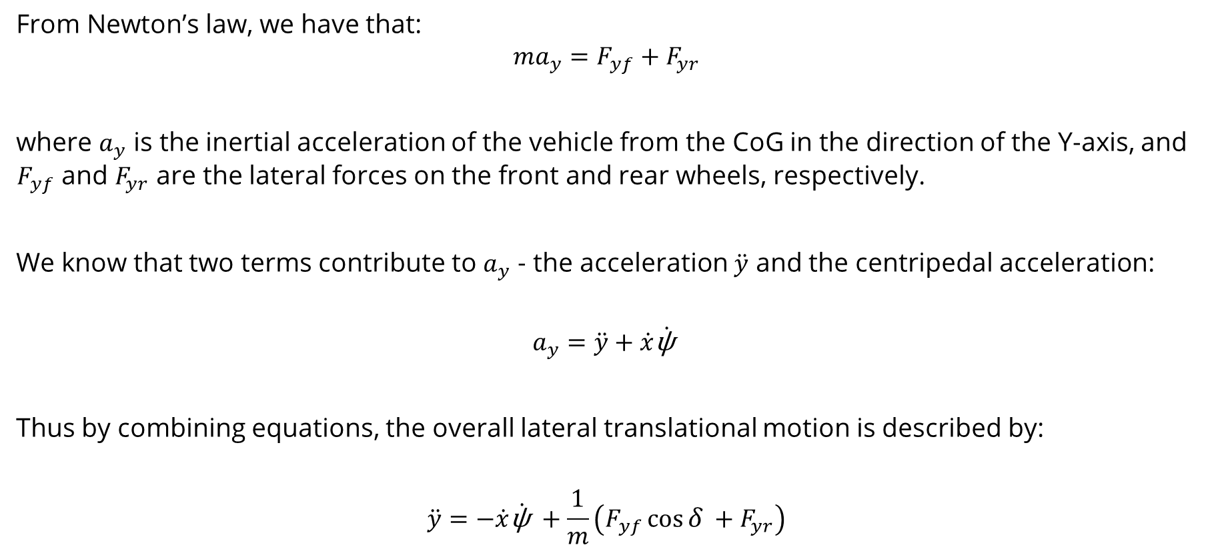
Deriving the Dynamic Equations, Pt. 1
From Newton’s law, we have that:
$$ma_{y}=F_{yf}+F_{yr}$$
where $a_{y}$ is the inertial acceleration of the vehicle from the CoG in the direction of the Y-axis, and $F_{yf}$ and $F_{yr}$ are the lateral forces on the front and rear wheels, respectively.
We know that two terms contribute to $a_{y}$ - the acceleration $\ddot{y}$ and the centripedal acceleration:
$$a_{y}=\ddot{y}+\dot{x}\dot{\text{ψ} }$$
Thus by combining equations, the overall lateral translational motion is described by:
$$\ddot{y}=−\dot{x}\dot{\text{ψ} }+\frac{1}{m}\left({F_{yf}\cos{δ }+F}_{yr}\right)$$

Slide 5
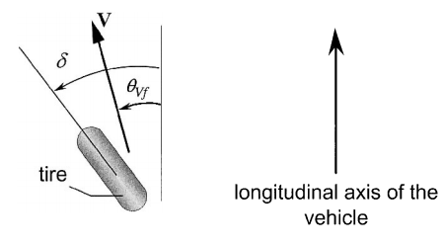
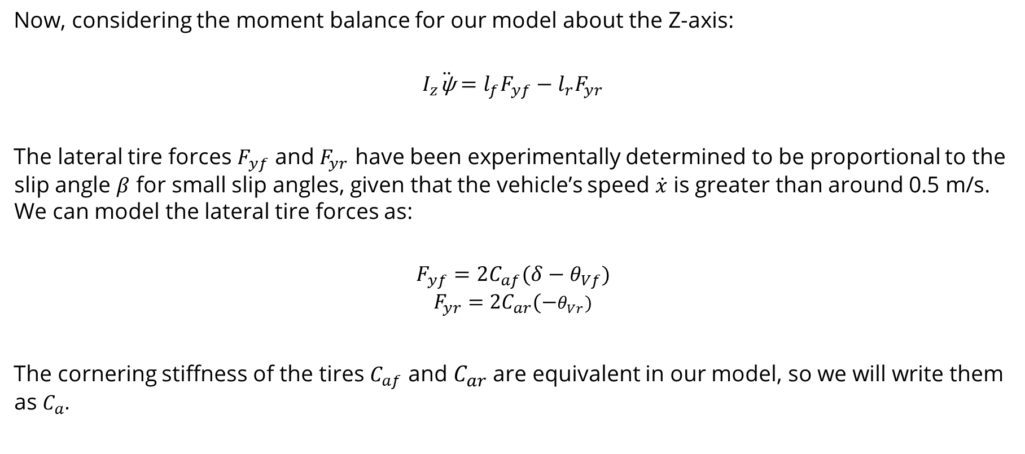
Deriving the Dynamic Equations, Pt. 2
Now, considering the moment balance for our model about the Z-axis:
$$I_{z}\ddot{\text{ψ}}={l_{f}F}_{yf}−{l_{r}F}_{yr}$$
The lateral tire forces $F_{yf}$ and $F_{yr}$ have been experimentally determined to be proportional to the slip angle $β$ for small slip angles, given that the vehicle’s speed $\dot{x}$ is greater than around 0.5 m/s. We can model the lateral tire forces as:
$$F_{yf}=2C_{af}(δ−θ_{Vf})$$
$$F_{yr}=2C_{ar}(−θ_{Vr})$$
The cornering stiffness of the tires $C_{af}$ and $C_{ar}$ are equivalent in our model, so we will write them as $C_{a}.$

Slide 6

Deriving the Dynamic Equations, Pt. 3
We can then use the small-angle approximation and some tricks to replace $θ_{Vf}$ and $θ_{Vr}:$
$$F_{yf}=2C_{a}\left(δ−\frac{\dot{y}+l_{f}\dot{\text{ψ} }}{\dot{x}}\right)$$
$$F_{yr}=2C_{a}\left(−\frac{\dot{y}+l_{r}\dot{\text{ψ} }}{\dot{x}}\right)$$
Now we can write our next dynamic equation (remember $I_{z}\ddot{\text{ψ}}={l_{f}F}_{yf}−{l_{r}F}_{yr}$):
$$\ddot{\text{ψ}}= \frac{2C_{a}l_{f}}{I_{z}}\left(δ−\frac{\dot{y}+l_{f}\dot{\text{ψ} }}{\dot{x}}\right)−\frac{2C_{a}l_{r}}{I_{z}}\left(−\frac{\dot{y}+l_{r}\dot{\text{ψ} }}{\dot{x}}\right)$$
Just one to go!

Slide 7
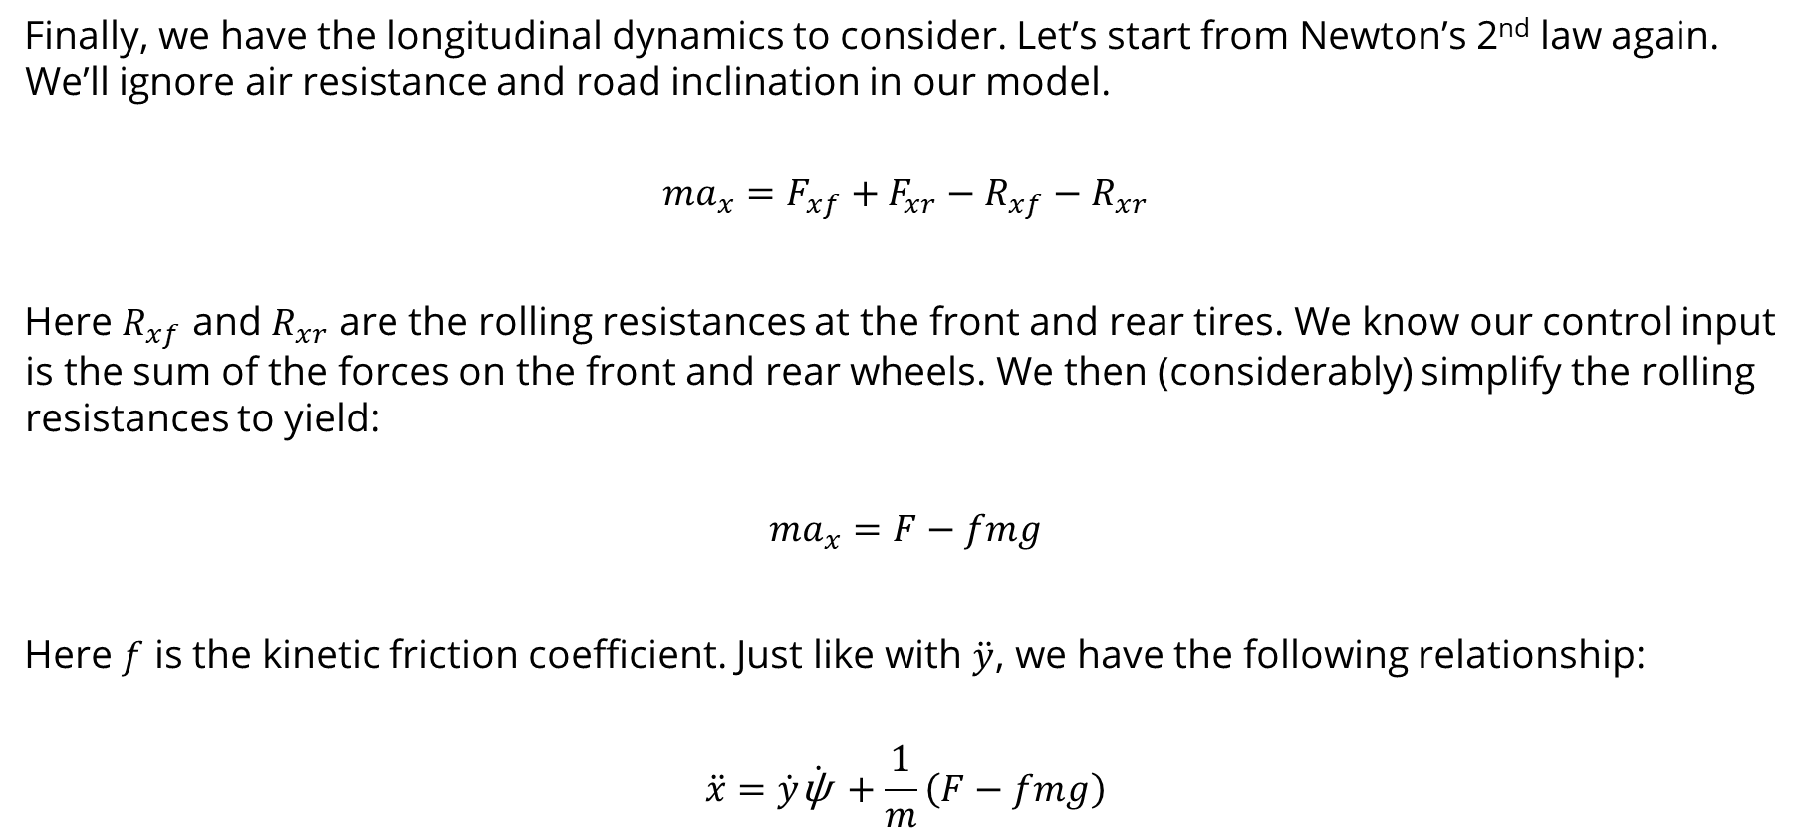
Deriving the Dynamic Equations, Pt. 4
Finally, we have the longitudinal dynamics to consider. Let’s start from Newton’s 2nd law again. We’ll ignore air resistance and road inclination in our model.
$$ma_{x}=F_{xf}+F_{xr}−R_{xf}−R_{xr}$$
Here $R_{xf}$ and $R_{xr}$ are the rolling resistances at the front and rear tires. We know our control input is the sum of the forces on the front and rear wheels. We then (considerably) simplify the rolling resistances to yield:
$$ma_{x}=F−fmg$$
Here $f$ is the kinetic friction coefficient. Just like with $\ddot{y}$, we have the following relationship:
$$\ddot{x}=\dot{y}\dot{\text{ψ} }+\frac{1}{m}\left(F−fmg\right)$$

Slide 8
References
1. Rajamani, Rajesh. Vehicle Dynamics and Control. Springer Science & Business Media,
2011.

